Slide 1
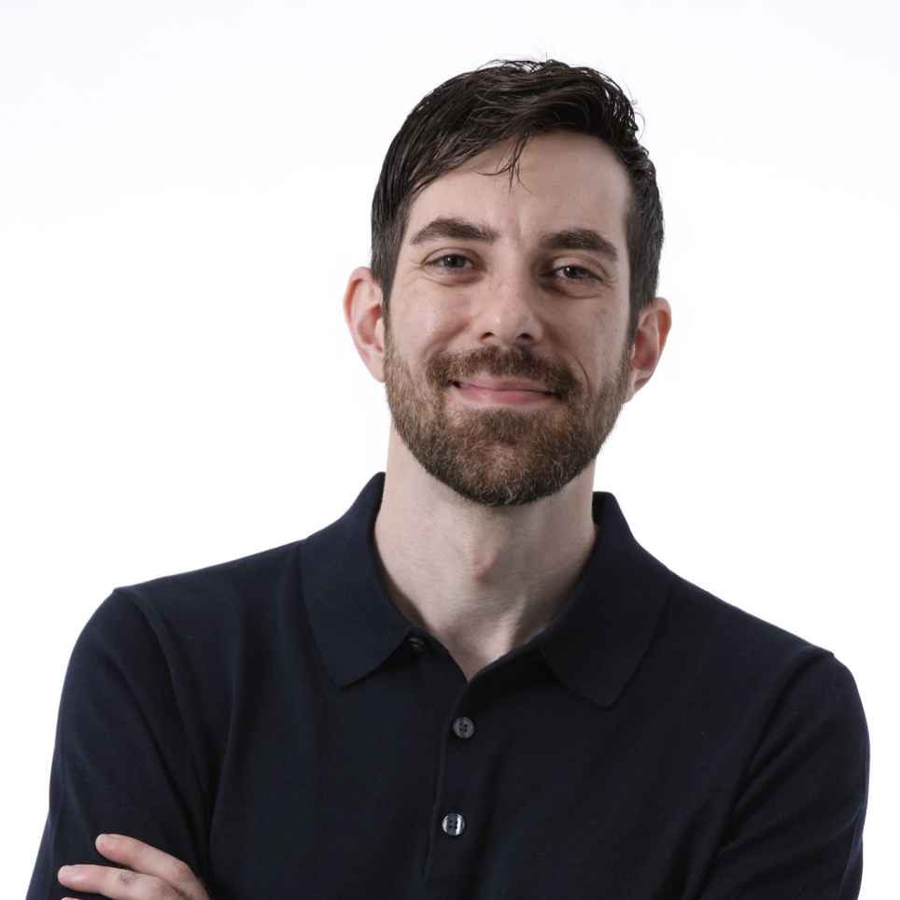
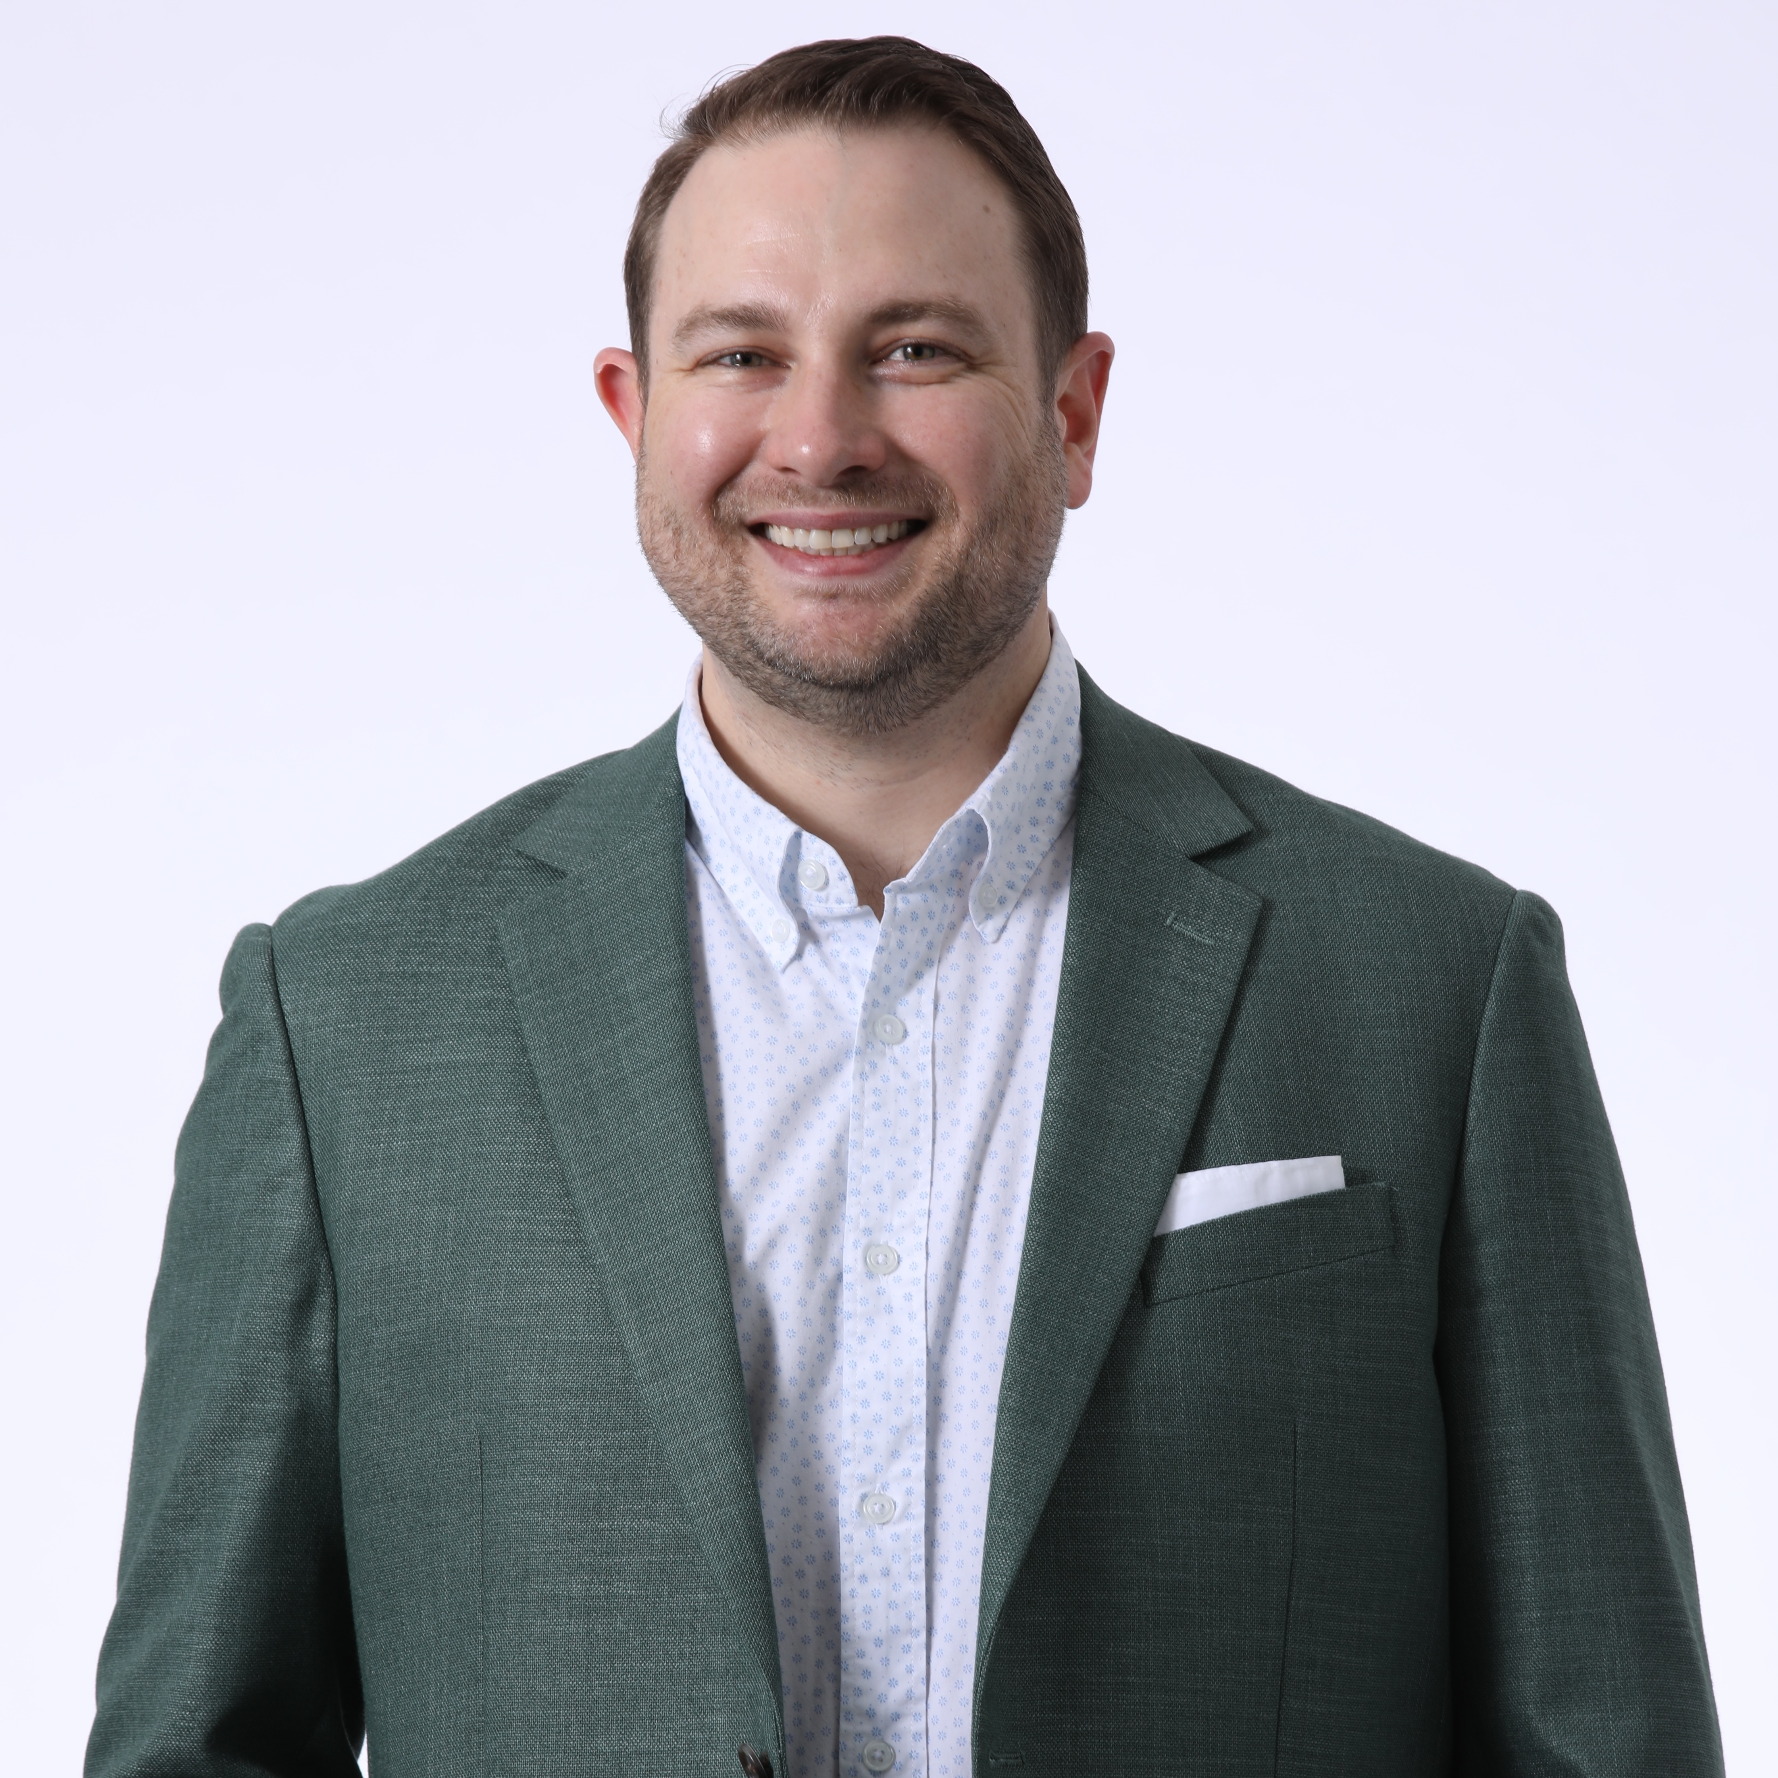
Ben Sullivan Director Experiences
Email
Ben.Sullivan@thebridge.com
Location
Dallas, Texas
Mobile
(405) 568-0992
Ben brings a unique approach to client business challenges by combining more than a decade of experience in creative advertising, digital marketing strategy, and management consulting.
Working with local and global household names in the entertainment, hospitality, and retail/CPG industries, Ben’s superpower is thinking through audience motivations and interactions. He loves turning the status quo on its head to understand where friction can be eliminated, and simplicity can be embraced.
EXPERIENCE
Industry Experience
Retail, Entertainment, Hospitality, Travel & Tourism, Gaming, Automotive, Healthcare, Professional Sports
Topgolf International
Led MVP product ownership and scaling of a proprietary inventory management and reservation capacity tool across 80+ venues throughout the U.S.
Toyota Motors of North America
Led blueprinting of a digital configuration and purchase platform for scaled implementation and adoption leveraging internal expertise and outsource managed services.
SKILLS
Regional Gaming & Entertainment Operator
Unified content management and presentation technology stacks across gaming, hospitality, entertainment, and retail entities crafting a single, cross-property view of customers to advance loyalty offerings and personalization
Marketing and Go-To-Market Strategy, Service Design Blueprinting, Scaled Technology Deployment, Program Strategy & Management, Client Leadership, Agency and Creative Services Operations.
AWARDS & CERTIFICATIONS
Dallas Regional Chamber Young Professionals Board of Directors
Certified Scrum Product Owner (CSPO)

